Slide 1

Book E-Rental Store Major Project
Session Jan 2017 – May 2017
Submitted By-:
Kishan Kumar
Computer Science and Engineering
School of Engineering and Technology
Roll No. 8C.S A-25
Enrolment No. jnu-jpr/2013/00093
Under-Guidance of-: Mr. Mudit Khetan And
Mr. Navneet Kumar Verma

Slide 2
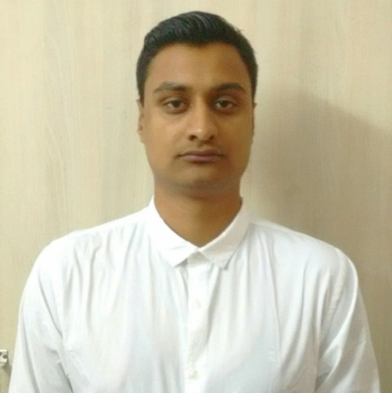
About Presenter
Name -: Kishan Kumar
S/o Sh. Kailash Nath Pandey
School -: School of Engineering And Technology
Branch -: Computer Science And Engineering
Session -: Aug 2013 to May 2017
Enrolment Number -: Jnu-jpr/2013/00093
Facebook -: https://www.facebook.com/kishan.kumar.5872
LinkedIn -: https://www.linkedin.com/in/kishan-kumar-86484292/
GitHub -: https://github.com/KumarKishan
Contact Number 9772015306
Project Detail -: https://github.com/KumarKishan/Book_Store
Notes:
Beginning course details and/or books/materials needed for a class/project.

Slide 3
Outline For Presentation
Sr. | Topic
1. | System Overview
2. | Need Of Project (Problem Faced)
3. | New Features Introduced in System
4. | System Analysis on Basis Of Market.
5. | Software Requirements Specification
6. | System Live Presentation
7. | Limitations and Future Scope
8. | Query's
Notes:
A schedule design for optional periods of time/objectives.

Slide 4

Introduction
First Online Book Rent Started in 2006.
It’s Saved 1 Million Peoples Money by Renting Book.
With the Help of Renting 90% of Student In U.S get Benefited.
Day By Day Its increasing World Wide.
Notes:
Introductory notes.

Slide 5

Need Of System
Chosen Such System Because I love to Read Book’s.
My Choice Was Limited and don’t want anyone else suffer like me.
It’s Help to Recycle Many Book’s Which are Only kept in Rack of Student’s.
Increasing Choice to read Books Increases Knowledge of people and Way of Thinking.
Notes:
Objectives for instruction and expected results and/or skills developed from learning.

Slide 6
Features Introduced
Our Plan:
Acknowledgment for Registration, sales and Arrival of New Books.
Feedback from Users.
New Users Registration.
Providing Free E Magazines to All Users Including Anonymous Users.
Notification On User Dashboard of Their Rent and Books status.
Report Generation Facility.
Easy Functionality for both User and Manager.
Loyalty Points.
Notes:
Relative vocabulary list.

Slide 7

Business Plan.

Slide 8

Software Requirement Specification
Rumours
Book E-Rental Store
Software Requirements Specification

Slide 9
System Live Presentation

Slide 10
Limitations and Future Scope
The Limitation are Related to Marketing Aspect or From Technical
Limitations are as Followed:
Delivery Option Not Available.
Limited to Single City.
Staffs are Not allowed as a Customers.
Fixed Returning Time.
Limited Books .
Future Scope-:
Expansion of Store to Multiple City.
Delivery to the Door.
24*7 Facility for Returning and Delivering Services.
Incrementing the Books Collection.
Easy User Interface.

Slide 11
Query's
If you have any Query's Just Tell Me below in Comment Box By Tagging Me
@Kishan.kumar464@gmail.com
Else anyone can Contact Me At-:
Kishan.kumar464@gmail.com
LinkedIn -: https://www.linkedin.com/in/kishan-kumar-86484292/
Note-:All the Files Link are Given in Description Box anyone can Access the file from That Link.

